Slide 1
WorkshopPLUS – Windows PowerShell: Tool Building

Slide 3
Instructor Introduction
Name
Specialty
Experience

Slide 4
Attendee Introductions
Name
Job/Team/Specialty
Your Experience with PowerShell

Slide 5

Objectives
After completing this WorkshopPLUS, you will be able to:
Create advanced functions
Create classes in PowerShell
Work with the debugger
Create GUI based PowerShell code

Slide 6
Modules and Agenda
3-4 Modules per day
Labs are around 45-60 minutes
Lunch break will be around noon
Knowledge Refresh
Developing Advanced Functions
Mastering Parameters
Classes
Day 1
Day 2
Day 3
Git Intermediate
Runspaces
Create a GUI in PowerShell
Error Handling
Git Introduction
Debugging
Final Lab – Apply Learning
Notes:
Module order can be changed to your preferences based on the below. You can select the bullets in the smart art to change them on the slide to your preferred delivery order.

Slide 7
Get Ready to Participate
Close email and Update Status
Open Group Chat
Prepare to be Called on

Slide 8


Getting the most from this class
Annotation tools
Emoticons
Voice discussions
…but stay engaged.
Stay muted…

Slide 9

Virtual Training Tour of your virtual classroom

Slide 10
Connect to Lab environment
Navigate to: https://aka.ms/lod
Sign in with your Microsoft account or Corporate Account (AAD)
If you do not have a Microsoft Account, create one at: https://account.microsoft.com/
Redeem Training Key: <KEY>
At the top of the page select WorkshopPLUS then My Training
Select Redeem Training Key
Enter Training Key
Edge Chromium recommended
Most modern browsers supported
Notes:
https://aka.ms/LearningCampus also works

Slide 11
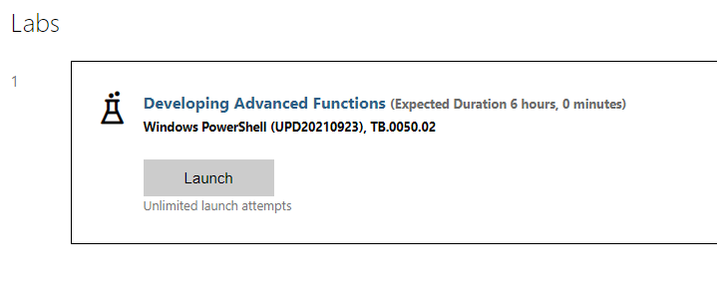
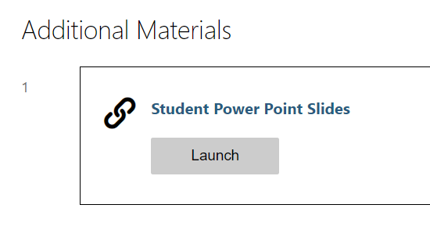
Class Portal
All labs and downloads are located on this page
Scroll down to the Labs section to see available labs you can launch
Scroll down to the bottom to Additional Materials section for the PowerPoint and other shared files
Notes:
As you are demoing this, it’s a good idea to mention there are optional self tests at the end of every lab.

Slide 12
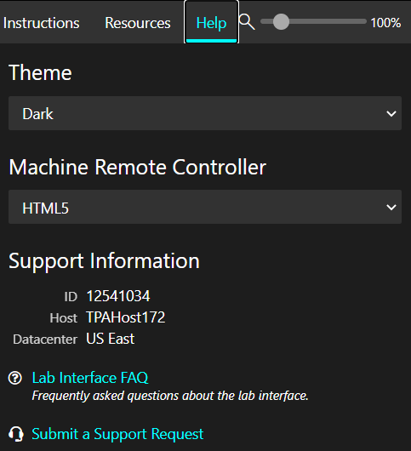
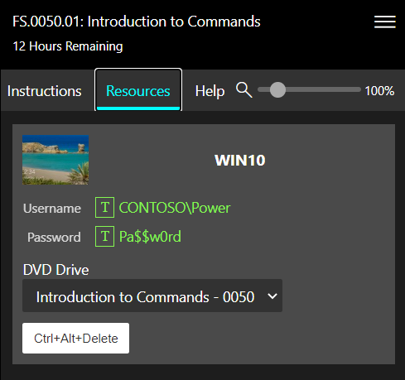
Lab Environment
The labs have 3 important tabs on the right side: Instructions, Resources, and Help
Resources contains accounts, passwords, and all machines required for the lab
Help allows you to change your theme and submit support requests

Slide 13
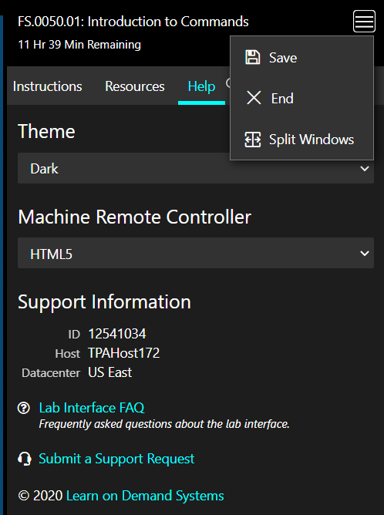
Lab Environment (≡)
Save
You can only have 2 saved labs at a time
End
Split Windows
This allows you to have a full screen lab
Pauses the lab to resume later.
Ends the lab and deletes the VMs
Moves the instructions and resources to a separate window

Slide 14
If you spot an issue in the Instructions, Labs or slides
Enable the Workshop Report Module in labs:
To improve this Microsoft Premier Workshop, Microsoft Premier Services would like to record any errors generated by this machines PowerShell sessions and upload telemetry error data only for the purpose of improving this workshops quality. There will be no user information, nor error to user correlation possible within the data upload to the Microsoft PowerBI system.
Press [Y] Yes, I do consent to upload error data to improve this workshops quality.
Press [N] No, I do not want to participate, no data will be uploaded.
Do you want to Support these Workshop improvements: y
Submit a feedback report:
Send-BugReport -LabChapter "2.5.6a" -Message "Spelling error" -Category Typo
Notes:
When you enable the WRT module all terminating errors that occure in the powershell session will be automatically submitted to the content creation team as a feedback submission.
Any manually found issues with a instruction or command can be submitted via the command:
Send-BugReport -LabChapter "2.5.6a" -Message "there is a typo in the word rady" -Category Typo

Slide 15
Microsoft

